Slide 1
Research Culture: aligned principles, diverse practices
All-Island Research Culture Network Conference, 2025
Karen Stroobants and Ben Bleasdale

Slide 2

Research culture – alignment and diversity
Research culture is still in its early stages of evolution as a movement
What's the right balance between alignment and diversity in our choices?
How do the choices we make now affect the future of reforms in this area?

Slide 3
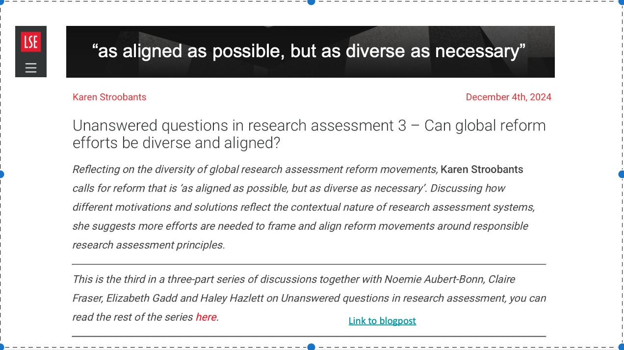

Slide 4


Research assessment - the nested challenge
Global Principles to Local Implementation:
    Global initiatives (CoARA, DORA, UNESCO)
    National frameworks
    Institutional policies
    Faculty implementation
    Individual experience
"As aligned as possible, but as diverse as necessary"
Credit: Sarah de Rijcke - GraspOS CoP talk

Slide 5

Balancing alignment and diversity?
Five balancing acts that will fundamentally shape the future of the RC movement:
  Definitions
  Ownership
  Funding
  Evidence
  Cooperation

Slide 6

Definitions
Terminology has emerged through evidence-underpinned problem statements
Led to evolving discussions on what is 'in' and 'out' of the RC umbrella
Many components pre-date the RC label as areas of reform, but progress differed
Who gets to make this in/out decision, and is full alignment on definitions a necessity?

Slide 7
Definitions
Alignment
Diversity
NCOB / Royal Society: initial problem statements; 'a common problem'
Vitae / Shift Insight framework: comprehensive co-development of common framework
Science Europe: framework for RCs
Wellcome: increased focus on 'people' (over other) elements
Institutions: setting out their own research culture definitions linked to respective mission and context
Definitions stemming from REF2029

Slide 8
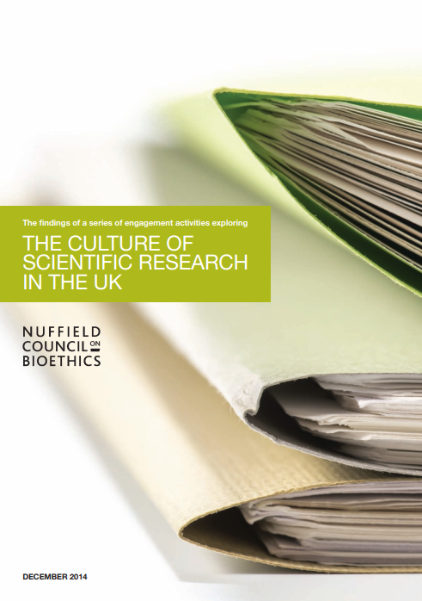
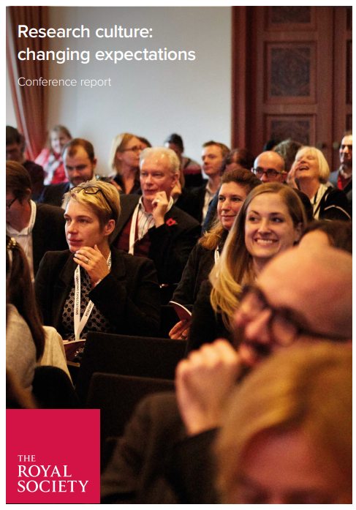

Initial reflection on what's in / out

Slide 9
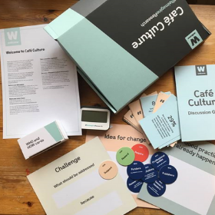
Ownership
RC movement emerges from a fragmented and often grassroots starting point
Shifts as larger voices - especially funders –join the conversation, but with continued efforts to keep broad collective ownership
Who sets the direction and decides the priorities? What is the optimal balance of centralising strategy and grassroots diversity?

Slide 10
Ownership
Alignment
Diversity
Founding voices: small community of advocates with shared mindset
Government and funder involvement: Government Strategy, Wellcome, REF
At best, this harmonises requirements and aligns rewards
Institutions: creating tailored RC strategies, often co-created with local research community to set priorities
Interest groups: within or across institutions, championing their priorities
Collectives – combine and magnify individuals voices (e.g. RCEN, pan-institutional initiatives, GPEx)

Slide 11
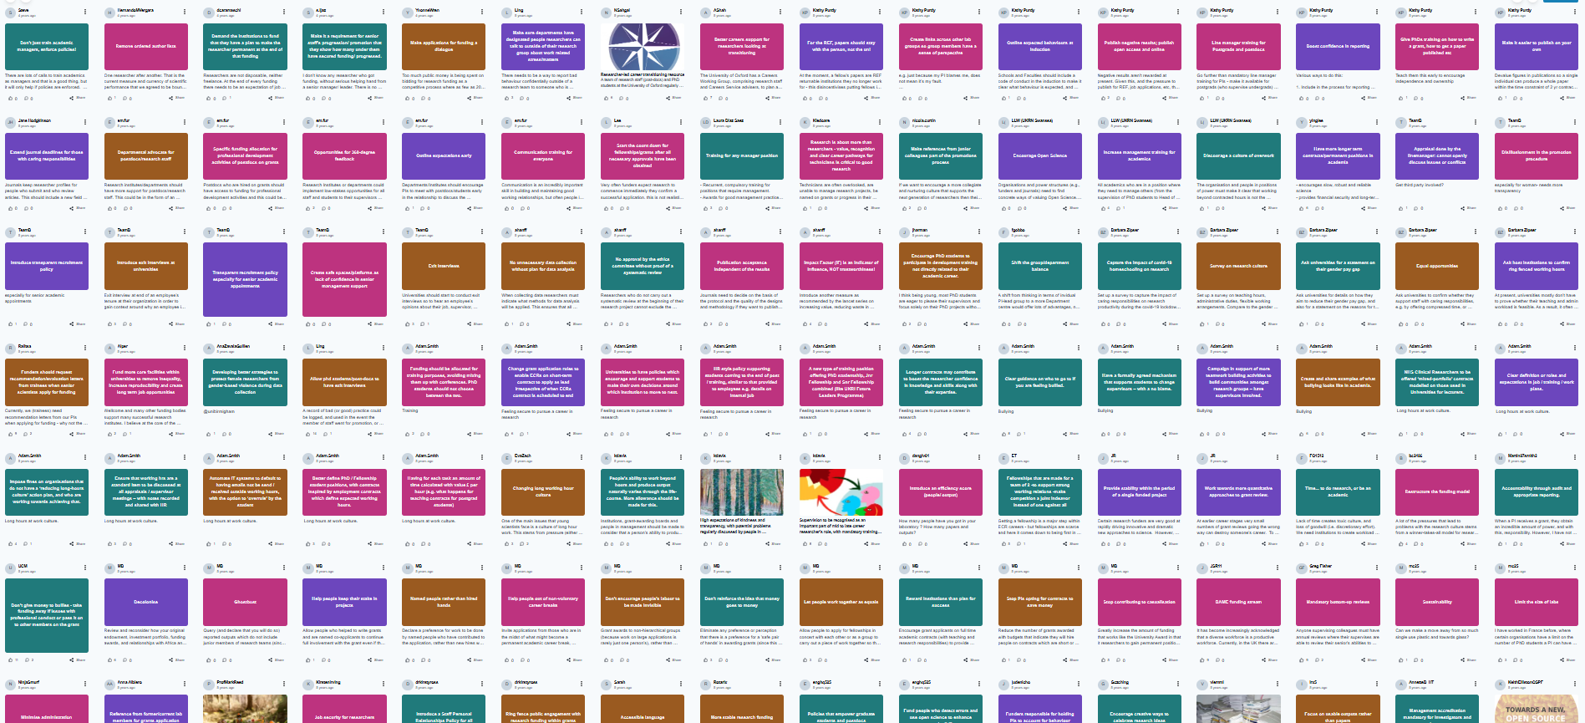
Co-creation as common thread

Slide 12

Funding
RC movement started with little to no dedicated resources
Major shift as funding opportunities appeared, but these have fallen unequally
The nature of the funding available will decide the mix of collaboration vs individualism
What is the optimal mix of competitive and non-competitive funding to best improve RC?

Slide 13
Funding
Alignment
Diversity
Wellcome IFRC: grant funding drives collaborative solutions and innovation, but limited eligibility in current form
RED Fund: promoted collaboration, with broader pool of eligible applicants
RE Enhancing RC Fund: block grant delegates ownership closer to the research community, but England only
Institutional funding: increasingly limited by tight finances of UK HEIs
REF PCE: centralises measures of success and drives competition, but also devolves block grants to institutions

Slide 14
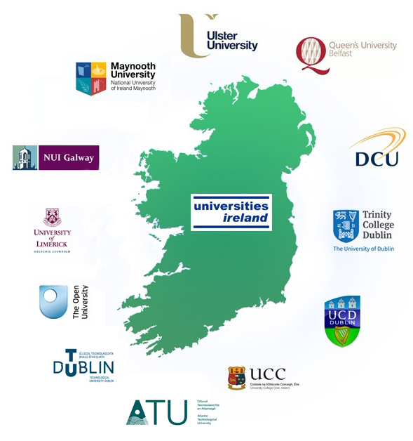
How does REF PCE affect RC choices?
Unique opportunity for an all-Ireland study of the impact of REF2029 PCE on RC choices
Strength of cross-border alignment provides a consistent baseline to start from
Track how the integration of PCE into REF influences RC on each side of the border
Inform choices across global RC community

Slide 15

Evidence
Progressing research culture means knowing what works, and doesn't
Assess impacts on fairness, as well as on research quality and impact
Important to recognise that what works in one place might not in another
How can we most effectively aggregate diverse evidence sources?

Slide 16
Evidence
Alignment
Diversity
RoRI and MetaScience Unit: building the evidence base needed to realise the full potential of research
UKRN COMET project: improve decision-making within institutions, by facilitating evidence-informed practice
UKRN METEOR findings: evidence-informed decision-making on RC issues is not yet embedded in institutions
Universities / funders: collecting evidence on outcomes and impacts of RC interventions
Good Practice Exchange (GPEx): shared platform, but must draw participation from all parts of community

Slide 17

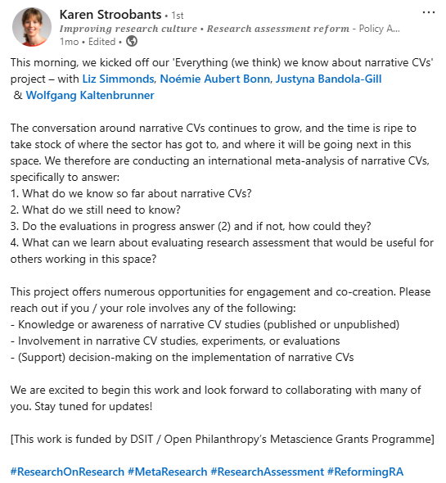
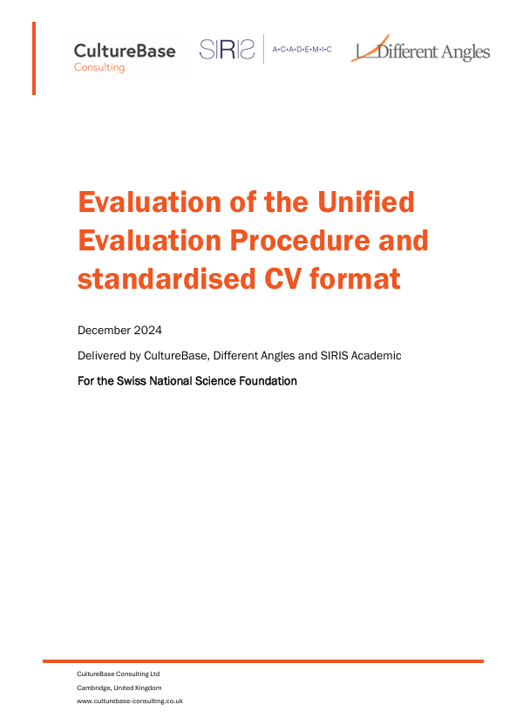
NCV example: analysis and meta-analysis

Slide 18

Cooperation
Cooperation across borders is essential to protect research mobility and the global nature of research
But perspectives and ambitions around RC should not be dominated by one part of the global research community
Expect to see tensions from differing value systems and competition for funding
What does "aligned as necessary" look like for effective global cooperation?

Slide 19
Cooperation
Alignment
Diversity
UK: GPEx as a new cooperation hub?
Europe: Science Europe values framework, and framework for RC
Global: while 'research culture' terminology is not universal, we see growing focus on RC umbrella themes (e.g. open science, assessment, EDI)
UK: REF ~ tension of integrating an intrinsically collaborative set of reforms into an ultimately competitive exercise
Global: geopolitical situation shifts the landscape for global alignment even at the level of values and principles...

Slide 20
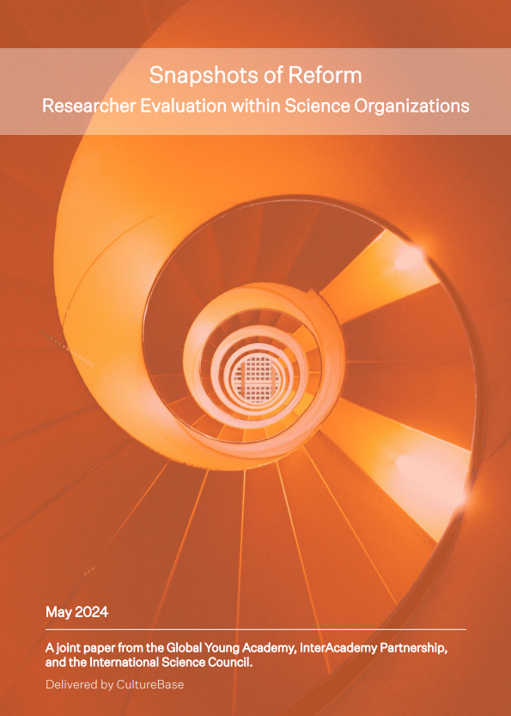
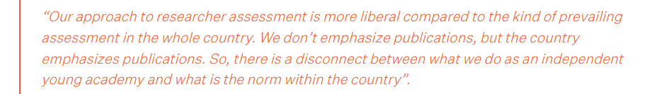
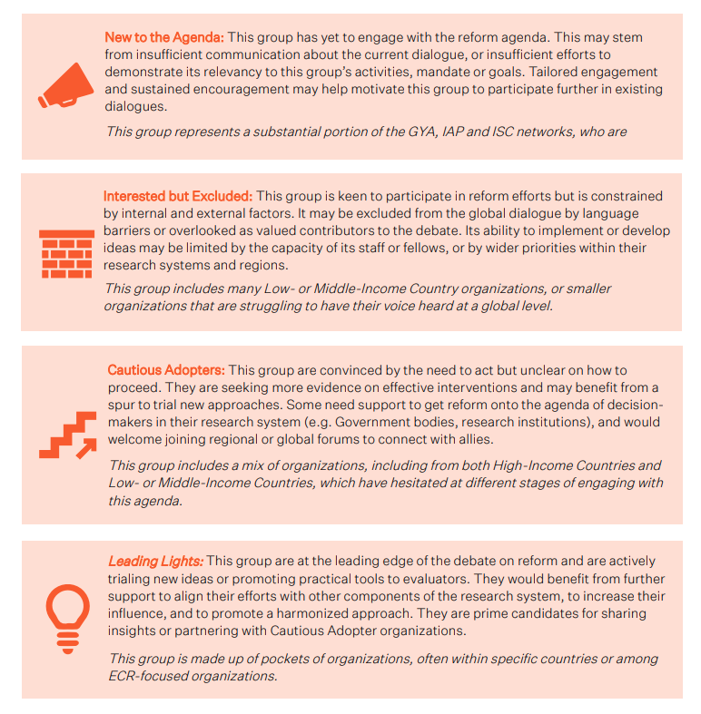
A patchwork of perspectives and activities

Slide 21
The path ahead
Geopolitics
Funding
Competition
How does the community react to core values coming under threat?
Where do we look for partners in the new landscape?
How do we pair increasing expectations with decreasing resource?
Where can we find cost-effective solutions?
How do we protect the cooperative nature of the existing RC movement?
How can we incentivise innovation and progress, without creating divisions?
Alignment and Diversity are bridged by knowledge exchange
Our community must nurture and protect 'structured diversity' as our greatest strength, especially amid emerging challenges ahead

Slide 22

Thank you
Karen Stroobants
karen@culturebase-consulting.co.uk
Ben Bleasdale
ben@culturebase-consulting.co.uk

